Slide 1
CSOPESY OS Emulator System
Command Recognition, Console UI, Command Interpreter, Process Representation, Scheduler Implementation

Slide 2
Introduction
The CSOPESY OS Emulator is a simulation of an operating system environment with an emphasis on process management, scheduling, and interaction through a command-line interface.
It is designed to demonstrate essential OS principles such as command recognition, scheduling, process representation, and batch processing.

Slide 3
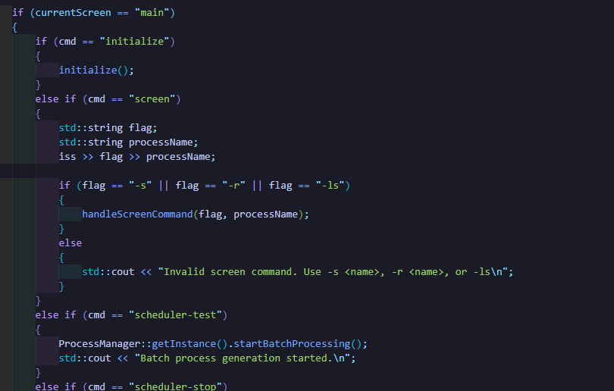
Command Recognition
The emulator supports a range of commands that initialize the system, manage processes, and display information. Each command is parsed and handled within the CLI class.

Slide 4
Detailed Command Recognition
The command recognition function is implemented in `CLI.cpp`. Here’s how it works:
1. **Parsing Commands**: The user input is parsed using an `istringstream`, breaking down the input to determine which command has been issued.
2. **Command Checking**: Each recognized command has a dedicated handler. For example, the `initialize` command calls a system initialization routine.
3. **Invalid Commands**: If an unrecognized command is entered, the system notifies the user of the invalid input.
This structure provides flexibility and enables easy expansion of command options.

Slide 5
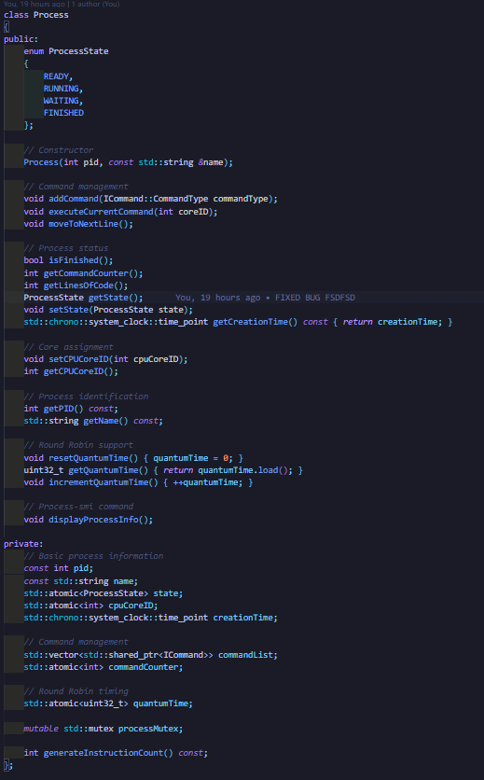
Process Representation
Processes are represented by the `Process` class, encapsulating attributes and methods for each simulated process.
name: The name of the process for ipid: A unique identifier for the process.
dentification.
state: Represents the current state of the process (READY, RUNNING, FINISHED), stored atomically for thread safety.
cpuCoreID: Tracks the CPU core currently executing the process (-1 if not assigned).
commandCounter: Keeps track of the progress through the process's commands.
quantumTime: Stores the allocated time slice for round-robin scheduling.
creationTime: The timestamp for when the process was created.
memoryRequirement: Dynamically generated to simulate memory usage.
commandList: A vector of shared pointers to commands, representing the process's instructions.
processMutex: Ensures thread-safe access to mutable attributes.

Slide 6
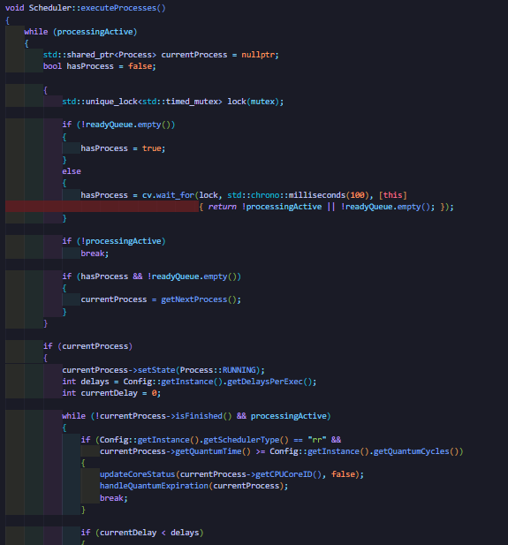
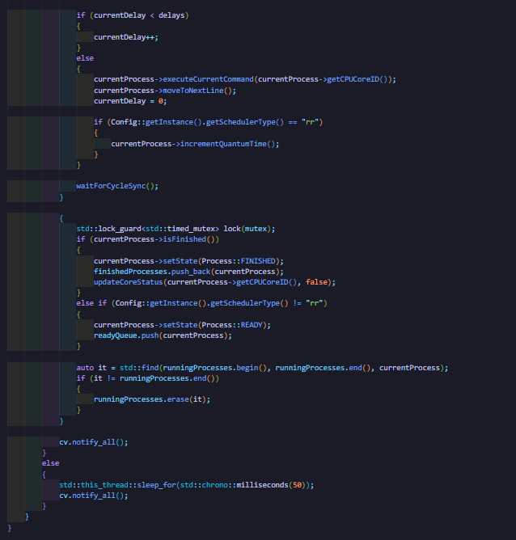
Scheduler Implementation
The scheduler manages the assignment of processes to CPU cores, supporting both First-Come, First-Served (FCFS) and Round-Robin scheduling algorithms.

Slide 7
Detailed Scheduler Implementation
1. **Queue Management**: The scheduler maintains separate queues for ready, running, and finished processes.
2. **Scheduling Algorithms**: Implements both `fcfsSchedule()` for FCFS and `roundRobinSchedule()` for Round-Robin scheduling.
3. **CPU Utilization**: The scheduler tracks core usage and generates a utilization report using `getCPUUtilization()`.
Each Process generates its memory requirement during initialization using the generateMemoryRequirement method.
This method retrieves configuration values (minimum and maximum memory per process) from the Config class and assigns a random memory value within this range.
Centralized Configuration:
Memory bounds are defined globally in the Config class, ensuring consistent memory allocation rules across all processes.
Scheduler's Role:
Although Scheduler doesn’t directly manage memory, it orchestrates process execution and ensures processes are executed within their allocated CPU cores and quantum times, indirectly influencing memory usage efficiency.
Potential for Extension:
Dynamic Memory Assignment:
While memory is currently generated and used per process without additional validation, you could extend the system to track total memory usage or implement checks to prevent over-allocation.

Slide 8
Memory Management Implementation
Initialization:
Total memory size and page size are set based on Config.
Determines the allocation strategy:
Flat Allocation: Single continuous memory blocks.
Page-Based Allocation: Divides memory into fixed-size pages and tracks allocations using a page table.
Allocation:
Flat Allocation:
Searches for a contiguous free block large enough for the process.
Splits blocks if necessary and marks them as occupied.
Deallocation:
Flat Allocation:
Marks blocks used by the process as free.
Merges adjacent free blocks to reduce fragmentation.
Page-Based Allocation:
Frees pages owned by the process and updates the page table.
Swapping:
Page-Based Allocation:
Allocates the required number of pages.
Updates the page table to track process ownership.
When memory is insufficient, the oldest non-active process is swapped out to free memory.
Adjusts usedMemory and updates the page table or memory blocks.
Statistics:
Tracks memory usage, free memory, pages paged in, and pages paged out.
Thread Safety:
Uses std::mutex to ensure safe concurrent access to memory structures.

